Slide 1


A Simple Calculation
Name(s): Ja’Marius Jackson, and Isabella Perrotti
Intro to Computer Science & Software Engineering
October 18th, 2025

Slide 2
The goal and the requirements
The goal for this project is to create a console-based calculator that can perform basic operations like addition, subtraction, multiplication, and division.

Slide 3
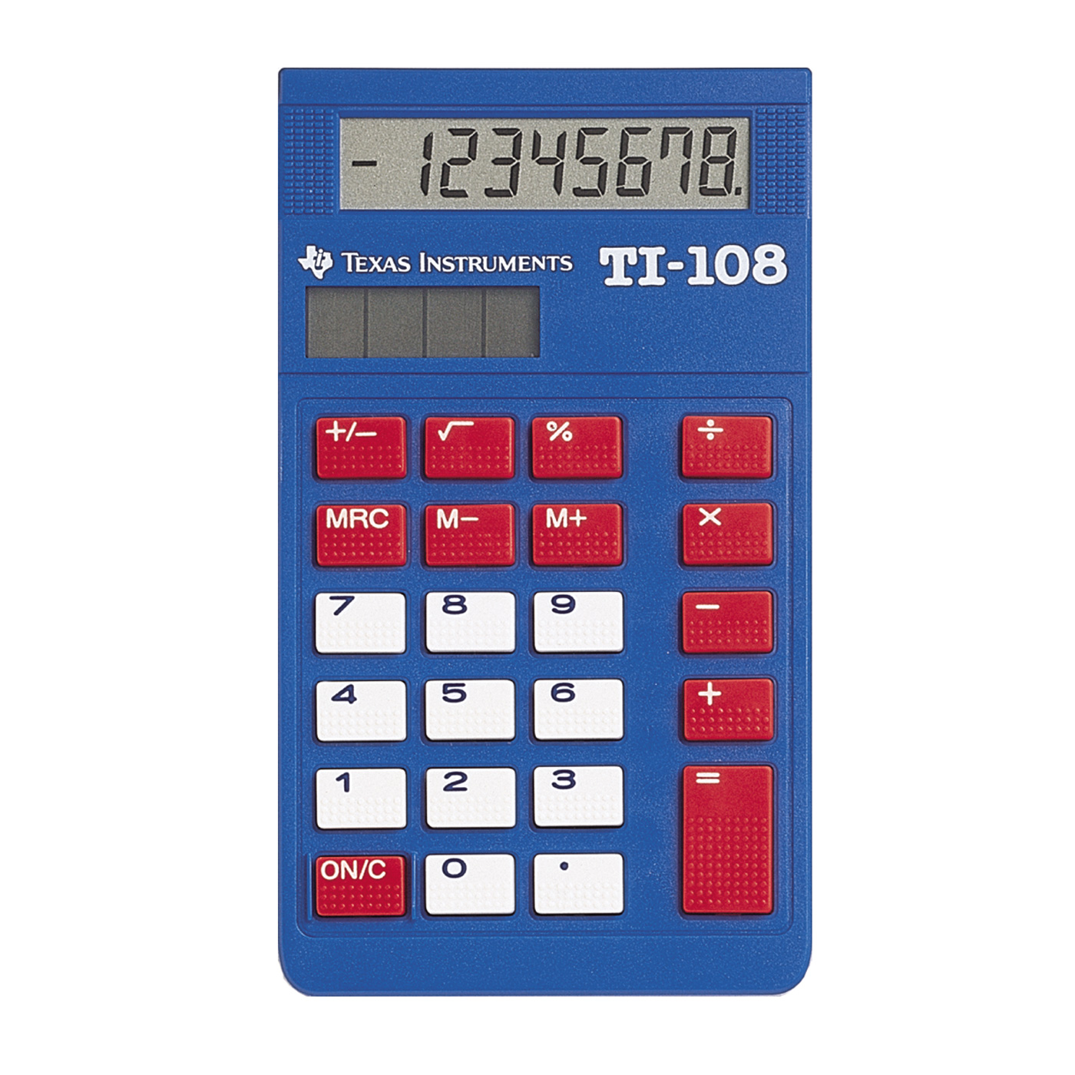
The goal and the requirements
The goal for this project is to create a console-based calculator that can perform basic operations like addition, subtraction, multiplication, and division.
Requirements: The requirements that we required for this project is basic standards on how to calculate through a basic calculator and with python. Furthermore, we require addition(+), division(÷), multiplication(×), and subtraction(–) to make the calculations we’ve selected. We also need numbers to calculate and know how to use them.

Slide 4
Introduction
Our group chose this title for our project because math is our

